Slide 1
Social networking analysis of the Full Disclosure email list
Jeffery Gerhard • gerhardj@gmail.com • @jeffgerhard
University of Maryland, College of Information Studies
for PERCEIVE • https://sailuh.github.io/perceive/

Slide 2


Introduction
Full Disclosure: "public, vendor-neutral forum for detailed discussion of vulnerabilities and exploitation techniques, as well as tools, papers, news, and events of interest to the community.“
http://seclists.org/fulldisclosure/
Notes:
Talk about and demonstrate how the list is set up (1 minute)
From Trello:
Part 1 -- manually inspecting the Full Disclosure list
The users of the Full Disclosure list identify themselves in several ways. A large proportion come from self-described security labs[1], which might consist of just one person, a group of individuals, or a “community project”[2]. Others give personal names, including author/discoverer information included as a detail in the text of their messages. Some authors use aliases that don’t apparently relate to personal names or security groups.
The types of postings appear to have shifted over time. In the early and mid-2000s, the list included a significant amount of trolling[3], nonsense[4] [5], and wide-ranging discussion[6]. Some discussions of security topics received dozens of responses[7] and led to heated debates. The list actually completely changed form in March of 2014[8] [9], and in recent years it seems to have less conversation, less spam and junk, and overall lower numbers of posts. Many of the people currently posting appear to be what I might call “gray hat hackers”[10] [11] who are searching for vulnerabilities and immediately posting them as part of the full disclosure philosophy[12]. There are a few who seem to be posting with possibly more malicious intent though, like listing information to assist people who are running botnets[13]. Some authors mention details of their interaction with vendors, like the fact that it was already reported but they haven’t heard anything back. Vendors also post to the list – for example, Apple[14] listing recent software updates that resolve security issues. Over the full history of the list, there are many conference listings, but that also seems to have dropped off recently as the list focuses more on vulnerabilities. However, even this week there a conference listed[15], so that aspect has not entirely disappeared.

Slide 3
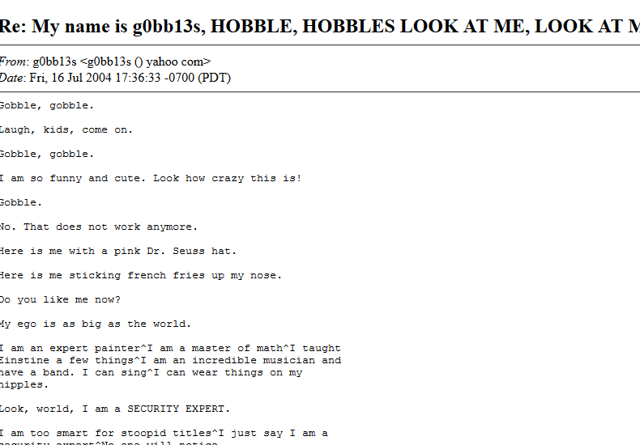
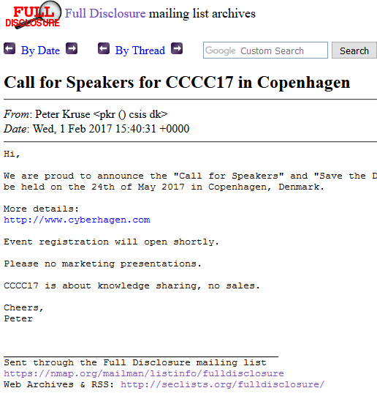
The problem: identifying relevant discussion topics
Notes:
1 minute+
From notebook:
## Problem Statement
Although cybersecurity email mailing lists provide a rich source to identify emerging concepts, it contains a large amount of content that is irrelevant to the project's purpose, including but not limited to:
* conference invitations[[1](http://seclists.org/fulldisclosure/2017/Feb/6)]
* vendor announcements[[2](http://seclists.org/fulldisclosure/2016/Dec/48)]
* extensive conversations on security topics[[3](http://seclists.org/fulldisclosure/2004/Jul/1026)]
* a significant amount of trolling[[4](http://seclists.org/fulldisclosure/2008/Apr/96)]
* and nonsense[[5](http://seclists.org/fulldisclosure/2009/Jul/289)] [[6](http://seclists.org/fulldisclosure/2004/Jul/796)].
As some of the irrelevant content can be strictly tied to it's producer, i.e., the **authors** of the **e-mail replies**, Social network analysis provides an interesting opportunity for the isolation of relevant discussion topics in order to **filter** non-related vulnerability content.

Slide 4
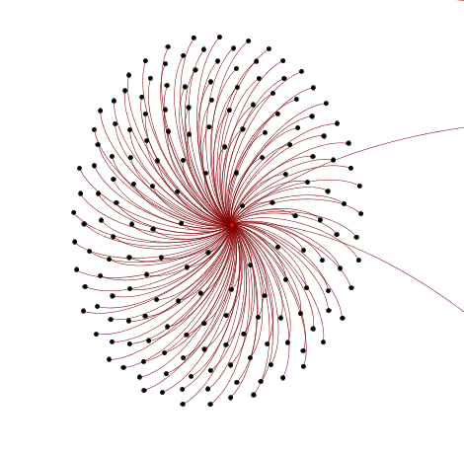
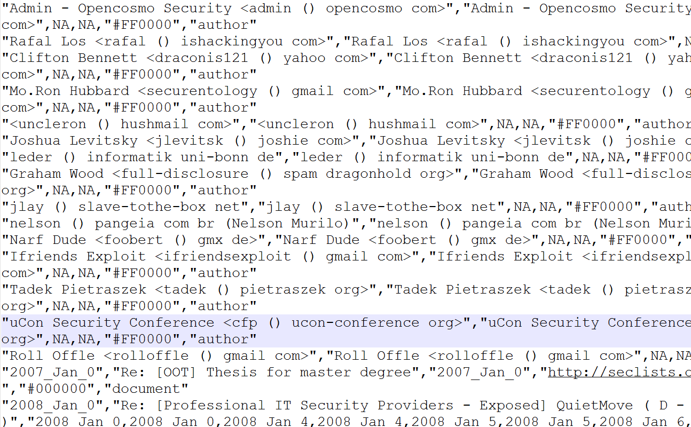
The network as graph
Notes:
1 minute
A predecessor on this project created node lists and edge lists for the email list by year – it looks like this [scroll in notepad++]
The graph nodes have two types, document and author, and they are connected by edges. The document nodes include URLs for the page where the email message is stored.
In graph visualizations, we can contrast the two node types with colors…

Slide 5
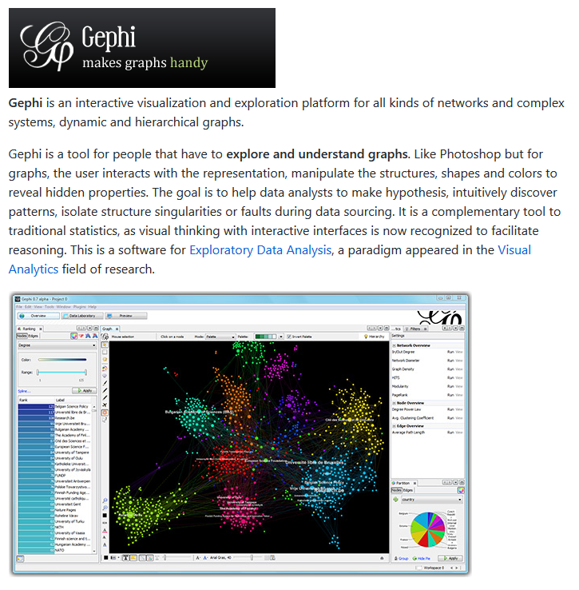
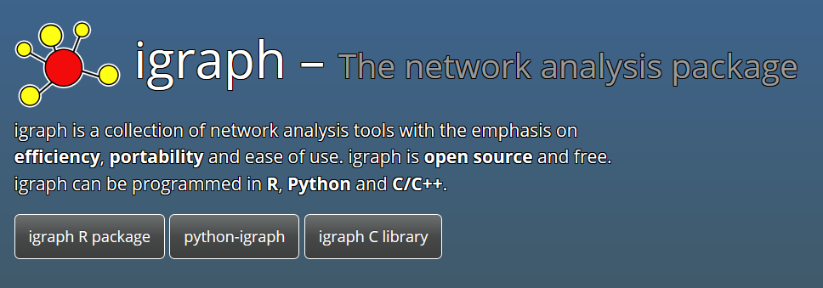
Tools used
gephi.org
igraph.org
Notes:
30 seconds
Problems of open source software (discontinued, no time for creators to work on it). Difficult to set up igraph on Windows!
## Considered Tools
### Gephi
While Gephi has provided useful for data exploration, some difficulties arised. In particular, many of the core functions[[7](https://github.com/jaroslav-kuchar/Social-Network-Analysis/issues/2)] and plugins[[8](https://github.com/gephi/gephi/issues/1481)] once used for social network analysis are not compatible with current (0.9) software versions. Gephi specifications note that the 0.9.0 version (December 2015) "Removed [the] Clustering module"[[9](https://github.com/gephi/gephi/releases/tag/v0.9.0)] that these plugins relied upon.
### Python-igraph
[Python-igraph](http://igraph.org/python/) (igraph hereafter) allows a user to import graphs in a variety of file formats, several of which match Gephi's export options. Brief tests demonstrated that the [GraphML](http://graphml.graphdrawing.org/) format was most successful for a workflow of transferring networks from Gephi to igraph. (Attempt to import [GML](https://en.wikipedia.org/wiki/Graph_Modelling_Language) and [Pajek](http://mrvar.fdv.uni-lj.si/pajek/) caused one instance of Python to hang; further investigation would be required to identify a cause.) The following examples use [GraphML files](https://mega.nz/#F!Dpdh2TjD!4Rd462mFXbdFn5Scs1WwUA) exported from Gephi.

Slide 6
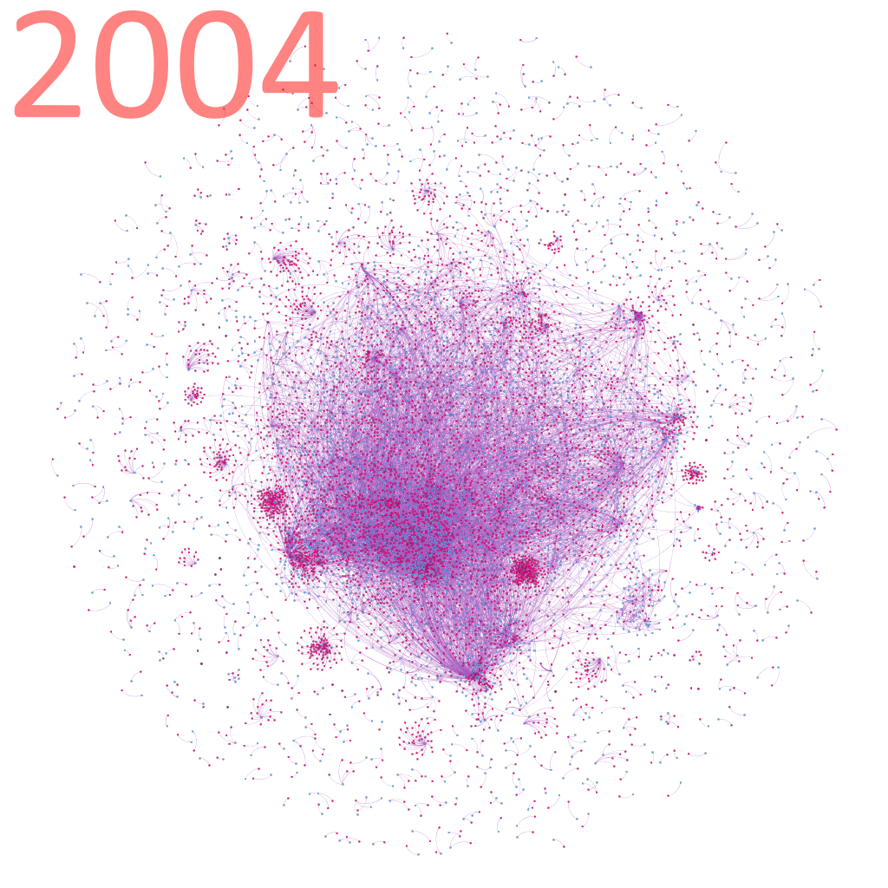
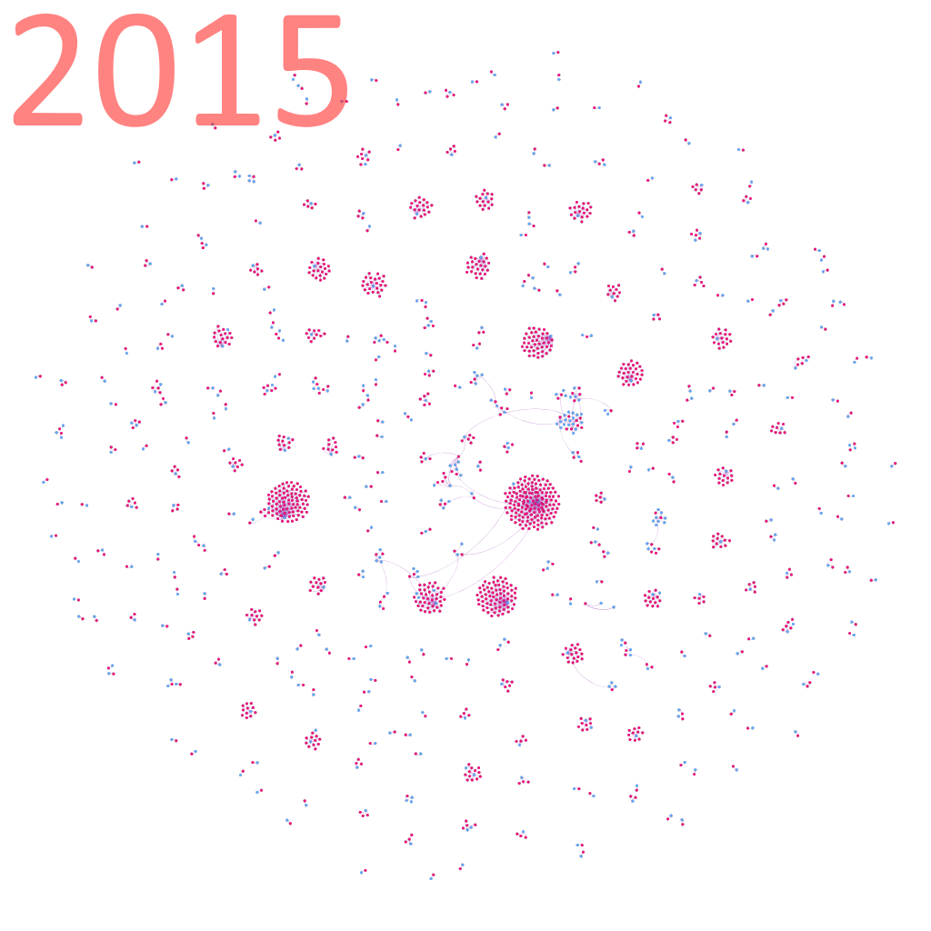
The birth and death of Full Disclosure
Notes:
2-3 minutes… show graph images shifting… show email
From Trello:
Part 4--
All of the years in the list show some “firework”-style features where a handful of users are posting a large number of separate documents. But it is clear from a quick look at the graphs that the overall pattern of the Full Disclosure network has shifted over time. In the original form of the list, there were tightly clustered conversations, especially from about 2003-2006. As the years went by, the level of discussion seems to have dropped. Following the format change in 2014, the number of edges drops significantly. (By the way, some of this can be predicted simply from looking at the file sizes of the original spreadsheets.) I would suggest that the current list, since 2014, displays a different network structure from the original list. Now, when security firms post information, it does not spark a conversation and there are barely any replies.
Since the proposal for my independent study used the example of 2008, it is worth starting there to consider some of the conversations going on outside of security firm announcements. Browsing through the emails from 2008, there are lots of discussions about things only tangential to security – like a long thread about switching cell phones off during plane travel. There are also lots of conversations involving a “security troll” called n3td3v.
It’s clear that for a number of years, people treated the FD list as a discussion forum that went far beyond security. It should be possible to manually examine a number of the heavy conversations and quickly identify their topic. This can help find patterns that later text analysis tools could use.

Slide 7
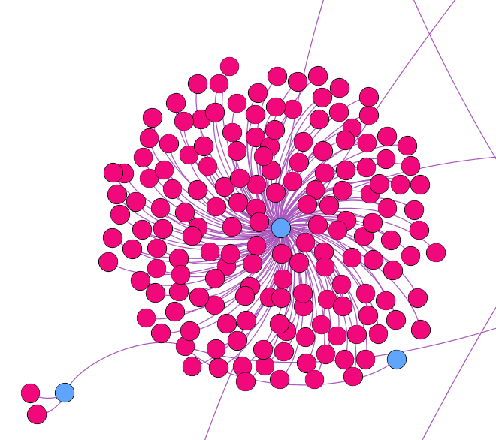
“Firework pattern”
Notes:
[5 min]
As an example, I will be working with the network for the year 2008. The same techniques developed here should be applicable to other years, with the caveat that the network structure appears to shift dramatically in later years.
Visual analysis of the graphs for each year showed distinct fireworks patterns throughout the lifecycle of the list. These are cases where one author is posting to the list multiple times, with little to no response from other people on the list. We hypothesize that these firework patterns mostly represent security advisories. These are known issues, and not interesting to our analysis.
It is possible to analyze these firework clusterings both visually, in Gephi, and programmatically, in igraph.
To accomplish this in Gephi, we can try a few things:
[do this with the fd2008.gephi file]
1. Simply zoom in on a firework and then turn on the labels
2. Using the Linkfluence plugin, we can jump directly to the URLs (they are in Label2)
Quick visual checking shows that our hypothesis is probably correct.
In igraph, we can also perform some simple calculations, like sorting authors by degree and looking at the in-degree of their connected (document) nodes. If all, or most of these neighbors have an in-degree of one, then we are in a firework. We can list the email subjects or link to the URLs to do some manual inspection.
[show how this works via a version of the notebook]

Slide 8
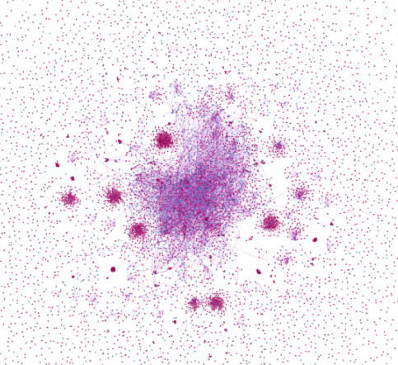
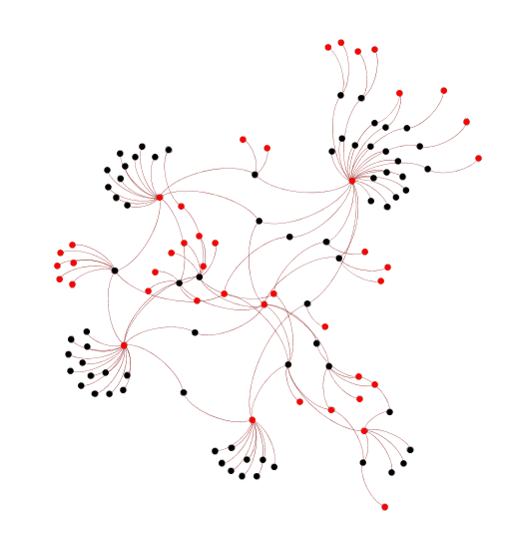
Filtering a network
Notes:
[3-4 min] To make social network analysis much more feasible, it was necessary to eliminate the fireworks from the graph. In igraph, this can be fairly straightforward by simply removing vertices that meet particular criteria. But there are judgment calls at every step, and it is necessary to do some extensive experimentation.
One year at a time hypothesis – emerging from literature on hacker vulnerabilities. Of course there are some instances in which people respond to things from years in the past, but we are assuming that nothing like that is critical, but it would be useful to keep in mind the change of years – for example, if list members are responding in January to topics from December.
But the examples I examined with huge time gaps appeared to be trolls.
[Go through the working version from the notebook – filtering out authors with neighbors of mostly in-degree 1 – I had to use an average bc some of these advisories do lead to an occasional response from somebody else. Therefore, we can’t simply identify them via in-degree of one for all the connected nodes. Experiments suggested that the exact number was not too important: <2, <1.5, <1.2 all pretty close in results.
Igraph automatically deletes all related edges when deleting a vertex. So I am doing another run-through to delete all the single nodes left, whether authors or documents. We’re left with a graph that is still very large, but hopefully something that we can use for social network analysis.

Slide 9
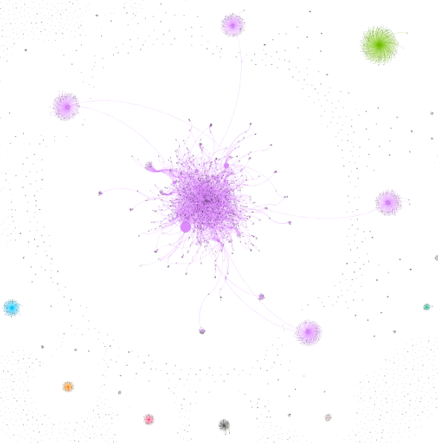
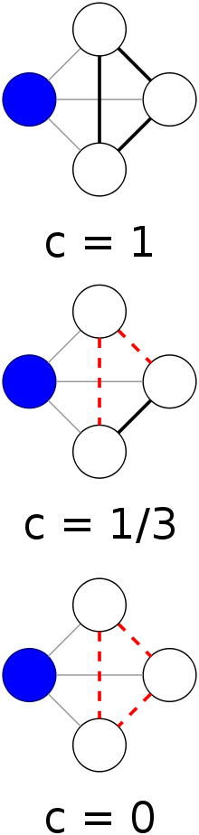
Clustering
https://en.wikipedia.org/wiki/Clustering_coefficient
Notes:
[4 min?]
In real-world social networks, there is a tendency towards clustering of nodes with strong ties: if I have a close friend who has another close friend, I am likely to make a connection with that person. Weak ties between clusters, though, are important for the spread of information, since closely linked clusters all share a lot of the same information. There are mathematical methods for identifying clusters based on the existing edges of their neighbors in comparison to the possible connections among them.
Both Gephi and igraph have clustering functions, but igraph’s are more robust and allow us to easily filter out subgraphs.
In the image to the right, we can see the entire 2008 graph colored by cluster. There are far too many clusters here to be meaningful – each of the fireworks is its own cluster, including hundreds of tiny clusters that might only consist of an author and an advisory posting.
In igraph, we can filter out the major fireworks and isolated nodes, and create a subgraph consisting only of the big blob in the middle. Then we can subdivide the blob into clusters again. This takes some experimentation – igraph allows us to suggest a desired number of clusters.

Slide 10
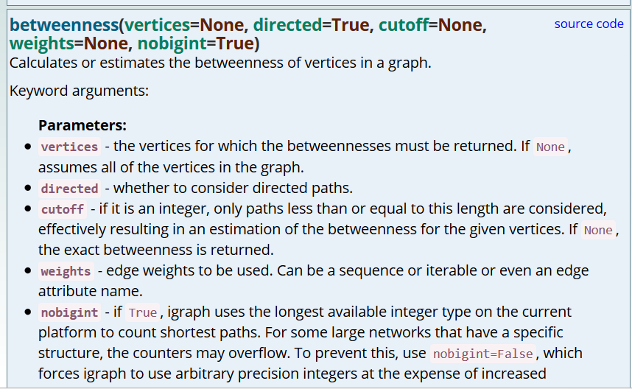
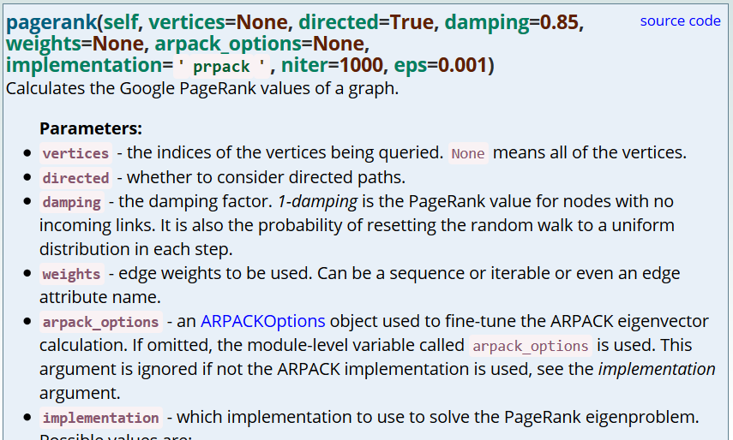
Centrality measures
http://igraph.org/python/doc/igraph.GraphBase-class.html#betweenness
http://igraph.org/python/doc/
igraph.Graph-class.html#pagerank

Slide 11
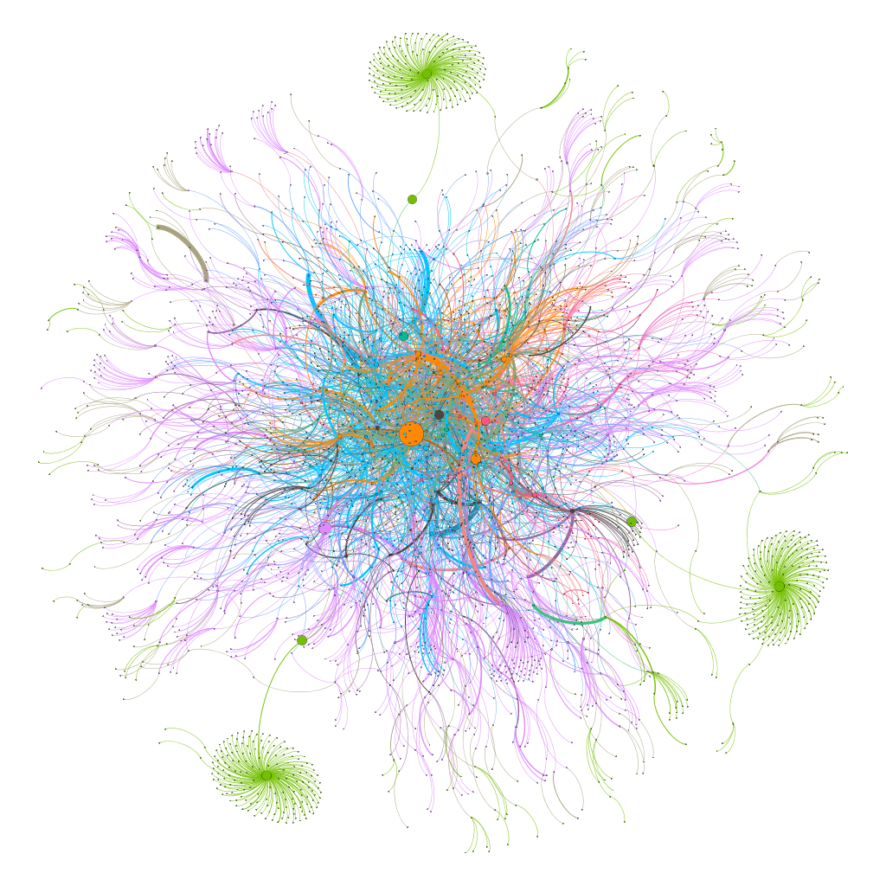
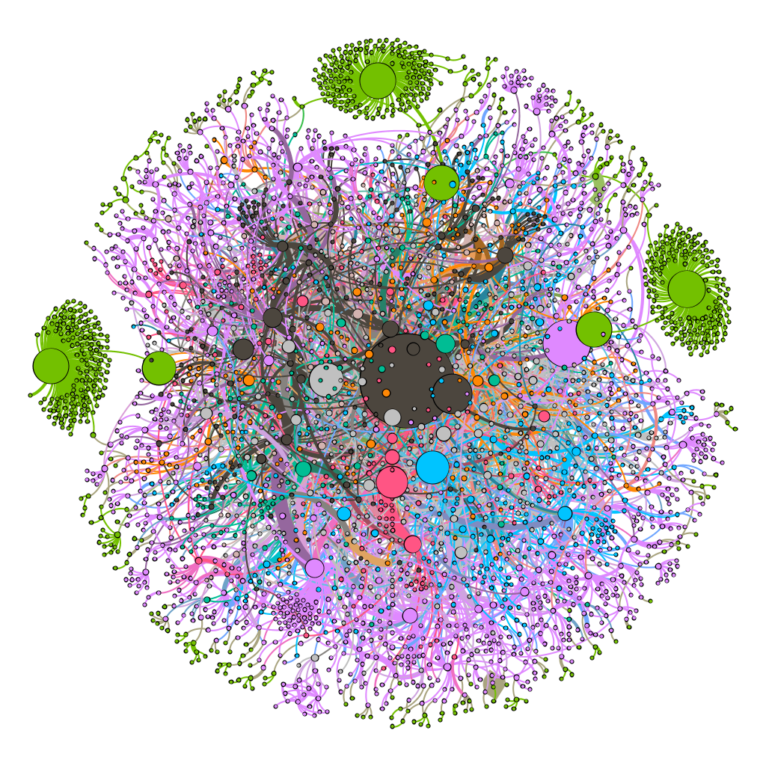
Breaking down the “blob” into further clusters
Notes:
[show different results in video form]
Key points:
we have similar results whatever the clustering is (purple clusters here are discussions going back and forth between multiple people with discussion.
We still have some fireworks that never got filtered out --- green clusters here

Slide 12
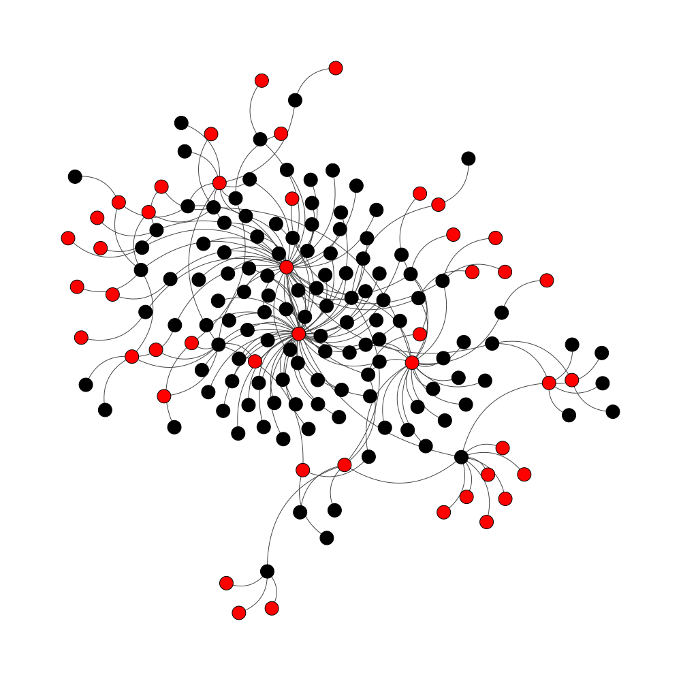
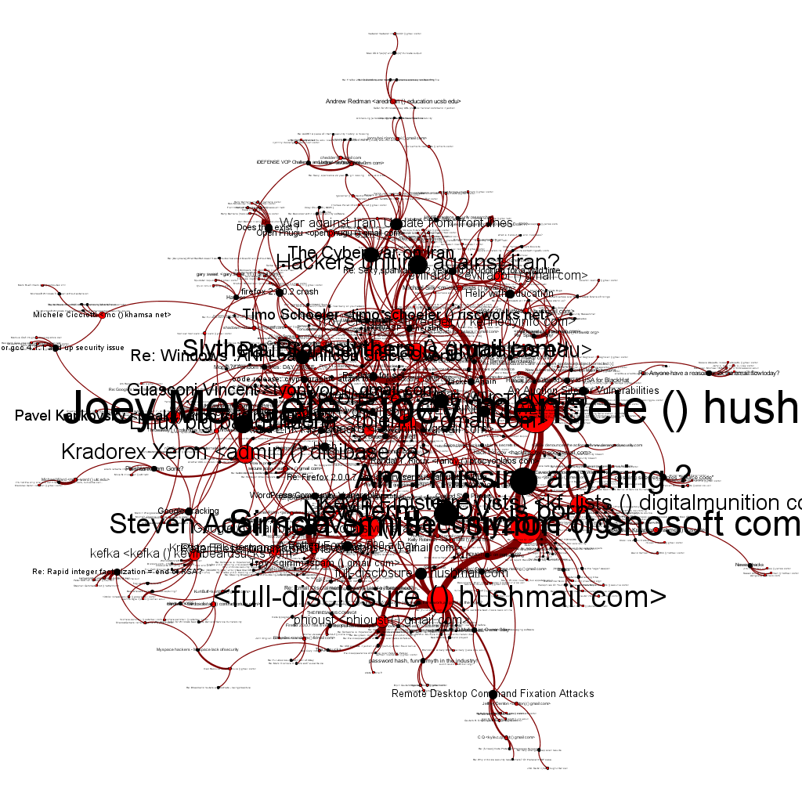
Analyzing the clusters in turn
Notes:
We can use igraph to split all the new clusters out into separate graphs and load those into gephi. For the most part, these no longer have firework clusters, but there are exceptions.
It is also possible to create graphs from within igraph for quick visual analysis

Slide 13
Wrapping up… for now…
Contact me – gerhardj@gmail.com
@jeffgerhard
jeffgerhard.com
github.com/jeffgerhard

